Slide 1

Slide 1
LEAD SCORING
Power Point Presentation
Submission by –
Shashank Sacamuri
Archana Khaware

Slide 2
Business Problem And GOAl
PROBLEM STATEMENT
An education company named X Education sells online courses to industry professionals. The company markets its courses on several websites and search engines like Google.
Once these people land on the website, they might browse the courses or fill up a form for the course or watch some videos. When these people fill up a form providing their email address or phone number, they are classified to be a lead. Moreover, the company also gets leads through past referrals.
Once these leads are acquired, employees from the sales team start making calls, writing emails, etc. Through this process, some of the leads get converted while most do not. The typical lead conversion rate at X education is around 30%.
BUSINESS GOAL
X Education has appointed you to help them select the most promising leads, i.e. the leads that are most likely to convert into paying customers.
The company requires you to build a model wherein you need to assign a lead score to each of the leads such that the customers with higher lead score have a higher conversion chance and the customers with lower lead score have a lower conversion chance.
The CEO, in particular, has given a ballpark of the target lead conversion rate to be around 80%.

Slide 3
METHODOLOGY
Data Loading, Cleaning and Preparation
Loading Data from Source
Feature Scaling and Data Splitting into Train-Test sets
Standardization of all Features that contain numerical data
Model Building
RFE and Manual methods for Feature Selection
Checking for duplicate data, missing values and their remediation
Handling Imbalanced Data (i.e. one value in majority and other one in minority) and Outliers
Data Analysis & Insight and creating Dummy Variables for categorical data
Splitting the dataset into Train and Test sets
Using Logistic Regression to determine the most optimal model
Determining various model metrics like accuracy, sensitivity, specificity, precision, recall, etc.
Model Evaluation
Conclusions
Calculating Lead Scores
Checking if final prediction correctly predicts 80% cases based on the actual conversion
Generating Predictions on the Test dataset using cut-off threshold from Accuracy, Sensitivity and Specificity metrics
Identifying Top 3 variables contributing to lead conversion

Slide 4

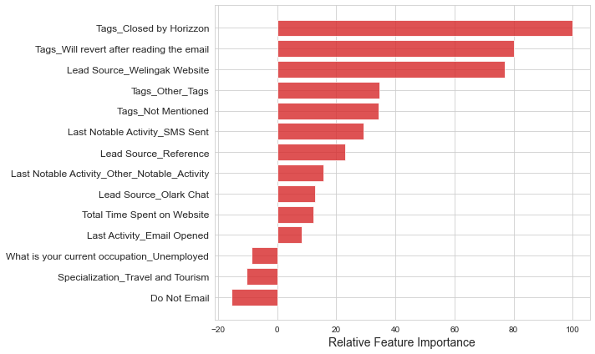
Slide 7
Features Contributing to Lead Conversion
Tags_Closed by Horizzon
Tags_Will revert after reading the email
Lead Source_Welingak Website
Tags_Other_Tags
Tags_Not Mentioned
Last Notable Activity_SMS Sent
Lead Source_Reference
Last Notable Activity_Other_Notable_Activity
Lead Source_Olark Chat
Total Time Spent on Website
Last Activity_Email Opened
What is your current occupation_Unemployed
Specialization_Travel and Tourism
Do Not Email

Slide 5

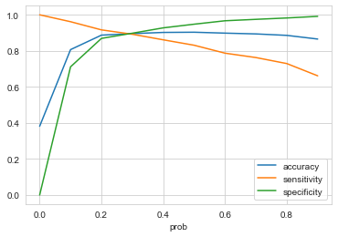
Slide 10
MODEL METRICS OF TRAIN DATASET (Sensitivity-Specificity)
Confusion Matrix
3533
(TN)
402
(FP)
262
(FN)
2166
(TP)
The cut-off threshold of Accuracy, Sensitivity and Specificity probability curves occurs at 0.3 as seen in above plotted diagram.
Accuracy = 89.6%
Sensitivity = 89.2%
Specificity = 89.8%
False Positive Rate = 10.2%
Positive Predictive Value = 84.3%
Negative Predictive Value = 93.1%

Slide 6
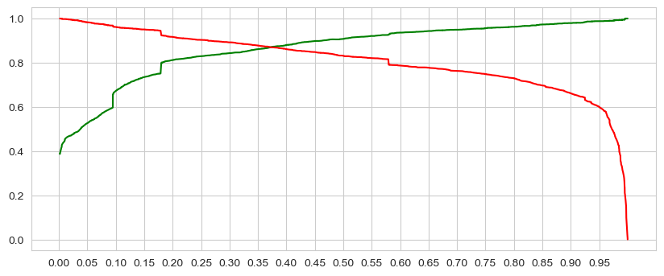
Slide 10
MODEL METRICS OF TRAIN DATASET (Precision-Recall)
Confusion Matrix
3730
(TN)
205
(FP)
410
(FN)
2018
(TP)
The cut-off threshold of Precision and Recall probability curves occurs at 0.37 as seen in above plotted diagram.
Precision = 90.8%
Recall = 83.1%
F-score = 86.8%

Slide 7
Slide 10
MODEL METRICS OF TEST DATASET (Sensitivity-Specificity)
Confusion Matrix
1500
(TN)
160
(FP)
Accuracy = 90.0%
Sensitivity = 89.3%
Specificity = 90.4%
114
(FN)
953
(TP)

Slide 8
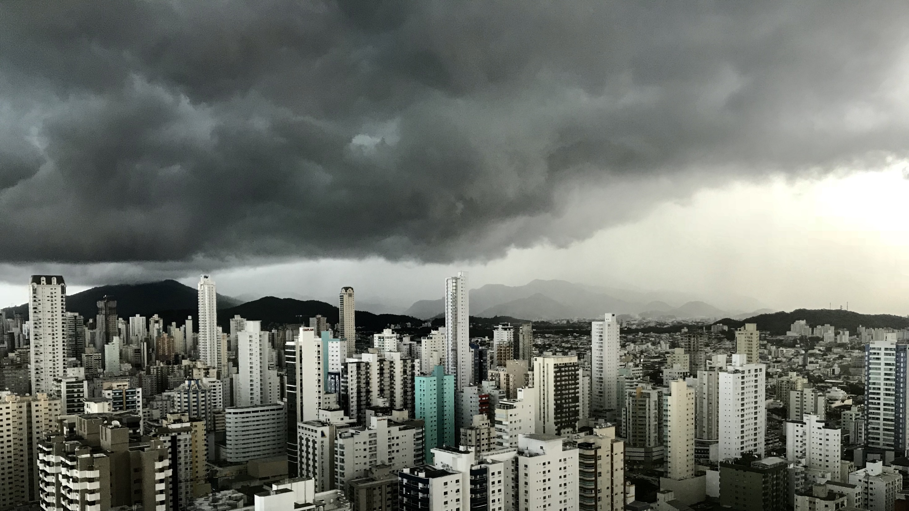
Slide 11
CONCLUSION
While we have checked both Sensitivity-Specificity as well as Precision and Recall Metrics, we have considered the optimal cut off based on Sensitivity and Specificity for calculating the final prediction.
Accuracy, Sensitivity and Specificity values of test set are around 90.0%, 89.3% and 90.4% which are approximately closer to the respective values calculated using training dataset (89.6%, 89.2% and 89.8%).
Also the lead score calculated in the training set of data shows the conversion rate on the final predicted model is around 92%.
Following are the categorical/dummy variables that should be focused the most in order to increase the probability of lead conversion:
a) Tags_Closed by Horizzon (from Tags)
b) Tags_Will revert after reading the email ( from Tags)
c) Lead Source_Welingak Website (from Lead Source)
Hence overall this model seems to be good.

